Slide 1

DEPARTMENT OF COMPUTER SCIENCE AND ENGINEERING
Diabetic Retinopathy Classification from Retinal Images using Machine Learning Approach
Under the Guidance of
Mr.R.Sreenivasulu
1
M.NAGASUPRIYA
R190970

Slide 2
Outline
2
Introduction bjective
Motivation
Related Works
Methodolo gy
Workflow
Results and Experimental Analysis
Discussions and Conclusion
References

Slide 3
ABSTRACT
3
Retinal image classification plays a critical role in the early diagnosis and treatment of various ocular diseases, including diabetic retinopathy, glaucoma, and age-related macular degeneration.This study presents a approach to retinal image classification using a convolutional neural network (CNN) architecture, specifically DenseNet121, known for its high efficiency and performance in image recognition tasks. The methodology involves the collection and preprocessing of retinal images, employing data augmentation techniques to enhance model generalization. The DenseNet121 model, pre-trained on ImageNet, is fine-tuned with additional custom layers to adapt it to the specific task of classifying retinal images into different disease categories Experimental results demonstrate that the DenseNet121-based model achieves high accuracy in classifying retinal images across multiple categories, showcasing its potential as a reliable tool for automated retinal disease diagnosis.

Slide 4
4
INDEX TERMS : Convolutional Neural Networks (CNN), DenseNet121, Age-Related Macular Degeneration, Medical Image Analysis, Model Evaluation, Healthcare Technology, Image Recognition, Disease Detection
Introduction
People with diabetes can have an eye disease called diabetic retinopathy.
It happens when high blood sugar levels cause damage to blood vessels in the retina.
It can damage the patient’s vision, even leads to blindness.
Our aim is to develop a system that will be able to identify patients with Diabetic Retinopathy from retinal colour fundus images.

Slide 5
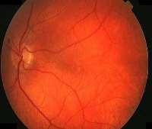
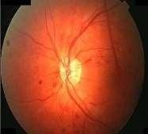
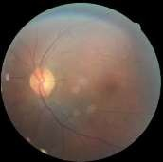
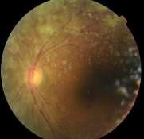
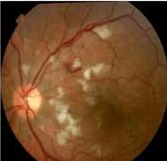
Data sets
5
(a) (b) (c)
(d) (e)
Fig 1 : (a) Healthy Eye (b) Mild NPDR (c) Moderate NPDR (d) Severe NPDR (e) PDR

Slide 6
objective
Process colour fundus retinal images for Diabetic Retinopathy detection.
Extract key features from the pre-processed images.
Detect the presence of Diabetic Retinopathy.
Classify whether the Diabetic Retinopathy Mild, Moderate, Severe or Proliferative.
6

Slide 7
Motivation
Diabetic Retinopathy (DR) is one of the common eye diseases and is a diabetes complication that affects eyes.
Diabetic retinopathy may cause no symptoms or only mild vision
problems. Eventually, it can cause blindness.
So early detection of symptoms could help to avoid blindness.
7

Slide 8
Related Works
Existing works performed DR detection using features of color fundus image like area and number of microaneurysm, exudates, appearance of haemorrhage etc.
Classification of DR has done by linear Naïve Bayes , SVM and NN classifiers.
Most of the works performed 2 and 3 class classifications. Whereas recent works like Acharya et al. had performed 5 class classification.
8

Slide 9
About the Data
9
The images consist of gaussian filtered retina scan images to detect diabetic retinopathy. The original dataset is available at APTOS 2019 Blindness Detection. These images are resized into 224x224 pixels so that they can be readily used with many pre-trained deep learning models. All of the images are already saved into their respective folders according to the severity/stage of diabetic retinopathy using the train.csv file provided. You will find five directories with the respective images:
No_DR
Mild
Moderate
Severe
Proliferate_DR

Slide 10
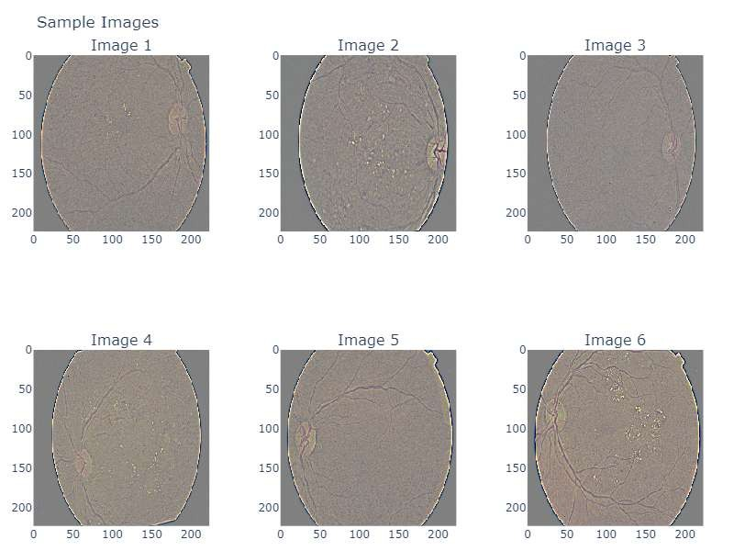
10

Slide 11
Methodology
Diabetic retinopathy detection system mainly consists three main steps:
Preprocessing of colour fundus images
Feature extraction
Classification of Diabetic Retinopathy
11

Slide 12
Preprocessing
12
Model Configuration for Retinopathy Classification
For the task of diabetic retinopathy classification, DenseNet121 is configured to take retinal images as input. The architecture is adjusted to include specific layers tailored for image classification tasks.
Accuracy: Measures the proportion of correctly classified images out of the total number of images.
Precision: Indicates the ratio of true positive predictions to the total number of positive , highlighting the model's ability to avoid false positives.

Slide 13
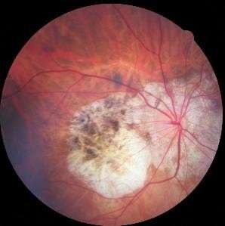
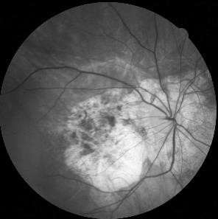
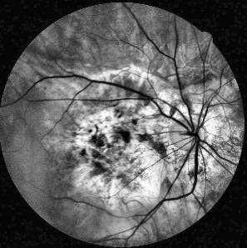
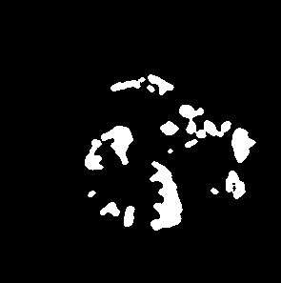
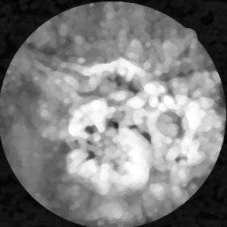
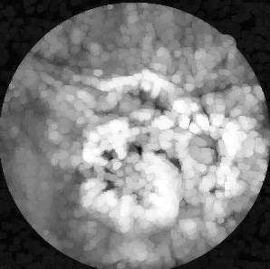
a) Input Image
b) Green Channel
c) CLAHE image
13
(
(
(
(
f
)
After
thresholding
(
e) Median
Filtered
(
d) After Dilation

Slide 14
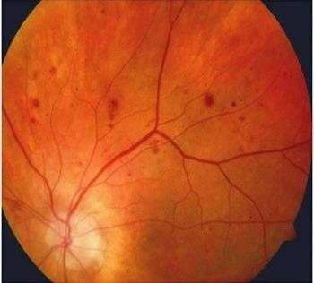
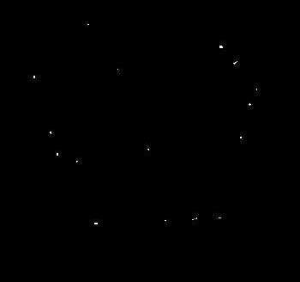
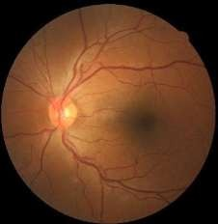
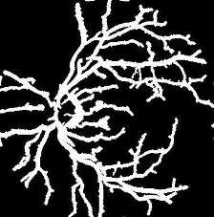
Feature Extraction
The features which are extracted to detect
Diabetic Retinopathy are-
14
Area of Exudates
Area of Blood Vessel
Area of Microaneurysms

Slide 15
The dataset is resampled to balance the number of images in each class, preventing the model from being biased towards any particular class.
Classifier parameters are fine tuned for the best performance.
Since random forest generates decision trees for prediction, several parameters are responsible for performance analysis.
Considering the features, we have used
No. of estimators = Number of trees in the forest = 3000
Max_features = max number of features considered for splitting a node = Number of features
Criterion = Gini index
Classification
15

Slide 16
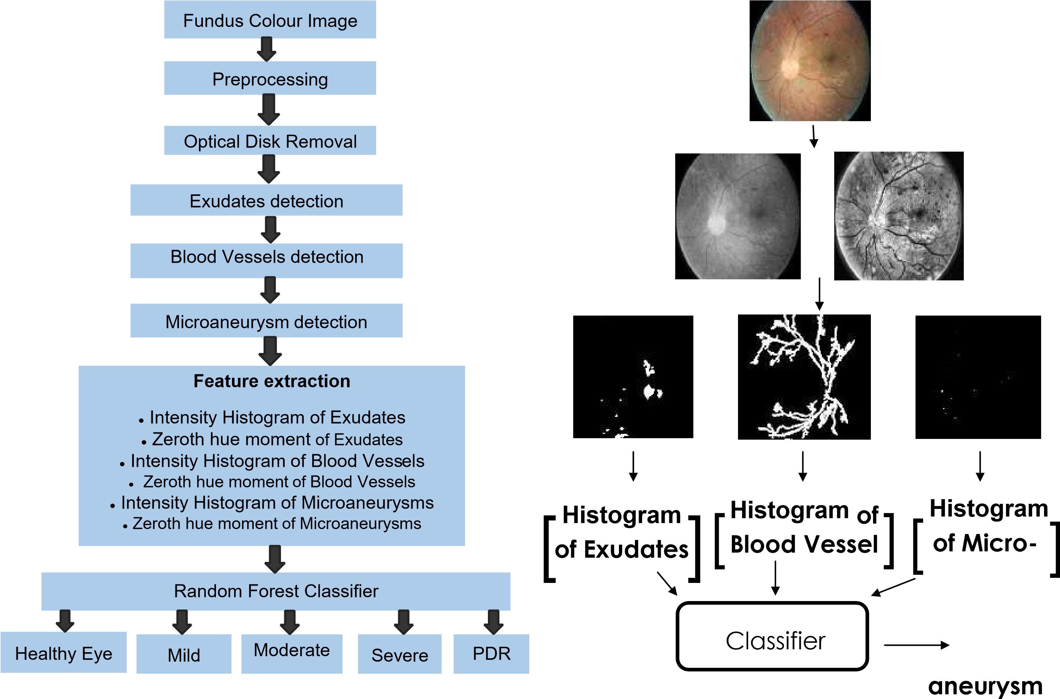
16

Slide 17
17
Evaluation Metrics
Accuracy, Sensitivity and Specificity are used as evaluation metrics of the model
𝑇𝑟𝑢𝑒 𝑃𝑜𝑠𝑖𝑡𝑖𝑣𝑒 +𝑇𝑟𝑢𝑒 𝑁𝑒𝑔𝑎𝑡𝑖𝑣𝑒
A𝑐𝑐𝑢𝑟𝑎𝑐𝑦 =
𝑇𝑜𝑡𝑎𝑙 𝑁𝑢𝑚𝑏𝑒𝑟 𝑜𝑓 𝐷𝑎𝑡𝑎
𝑇𝑟𝑢𝑒 𝑃𝑜𝑠𝑖𝑡𝑖𝑣𝑒
𝑆𝑒𝑛𝑠𝑖𝑡𝑖𝑣𝑖𝑡𝑦 =
𝑇𝑟𝑢𝑒 𝑃𝑜𝑠𝑖𝑡𝑖𝑣𝑒 +𝐹𝑎𝑙𝑠𝑒 𝑁𝑒𝑔𝑎𝑡𝑖𝑣𝑒
𝑇𝑟𝑢𝑒 𝑁𝑒𝑔𝑎𝑡𝑖𝑣𝑒
𝑆𝑝𝑒𝑐𝑖𝑓𝑖𝑐𝑖𝑡𝑦 =
𝑇𝑟𝑢𝑒 𝑁𝑒𝑔𝑎𝑡𝑖𝑣𝑒 +𝐹𝑎𝑙𝑠𝑒 𝑃𝑜𝑠𝑖𝑡𝑖𝑣𝑒

Slide 18
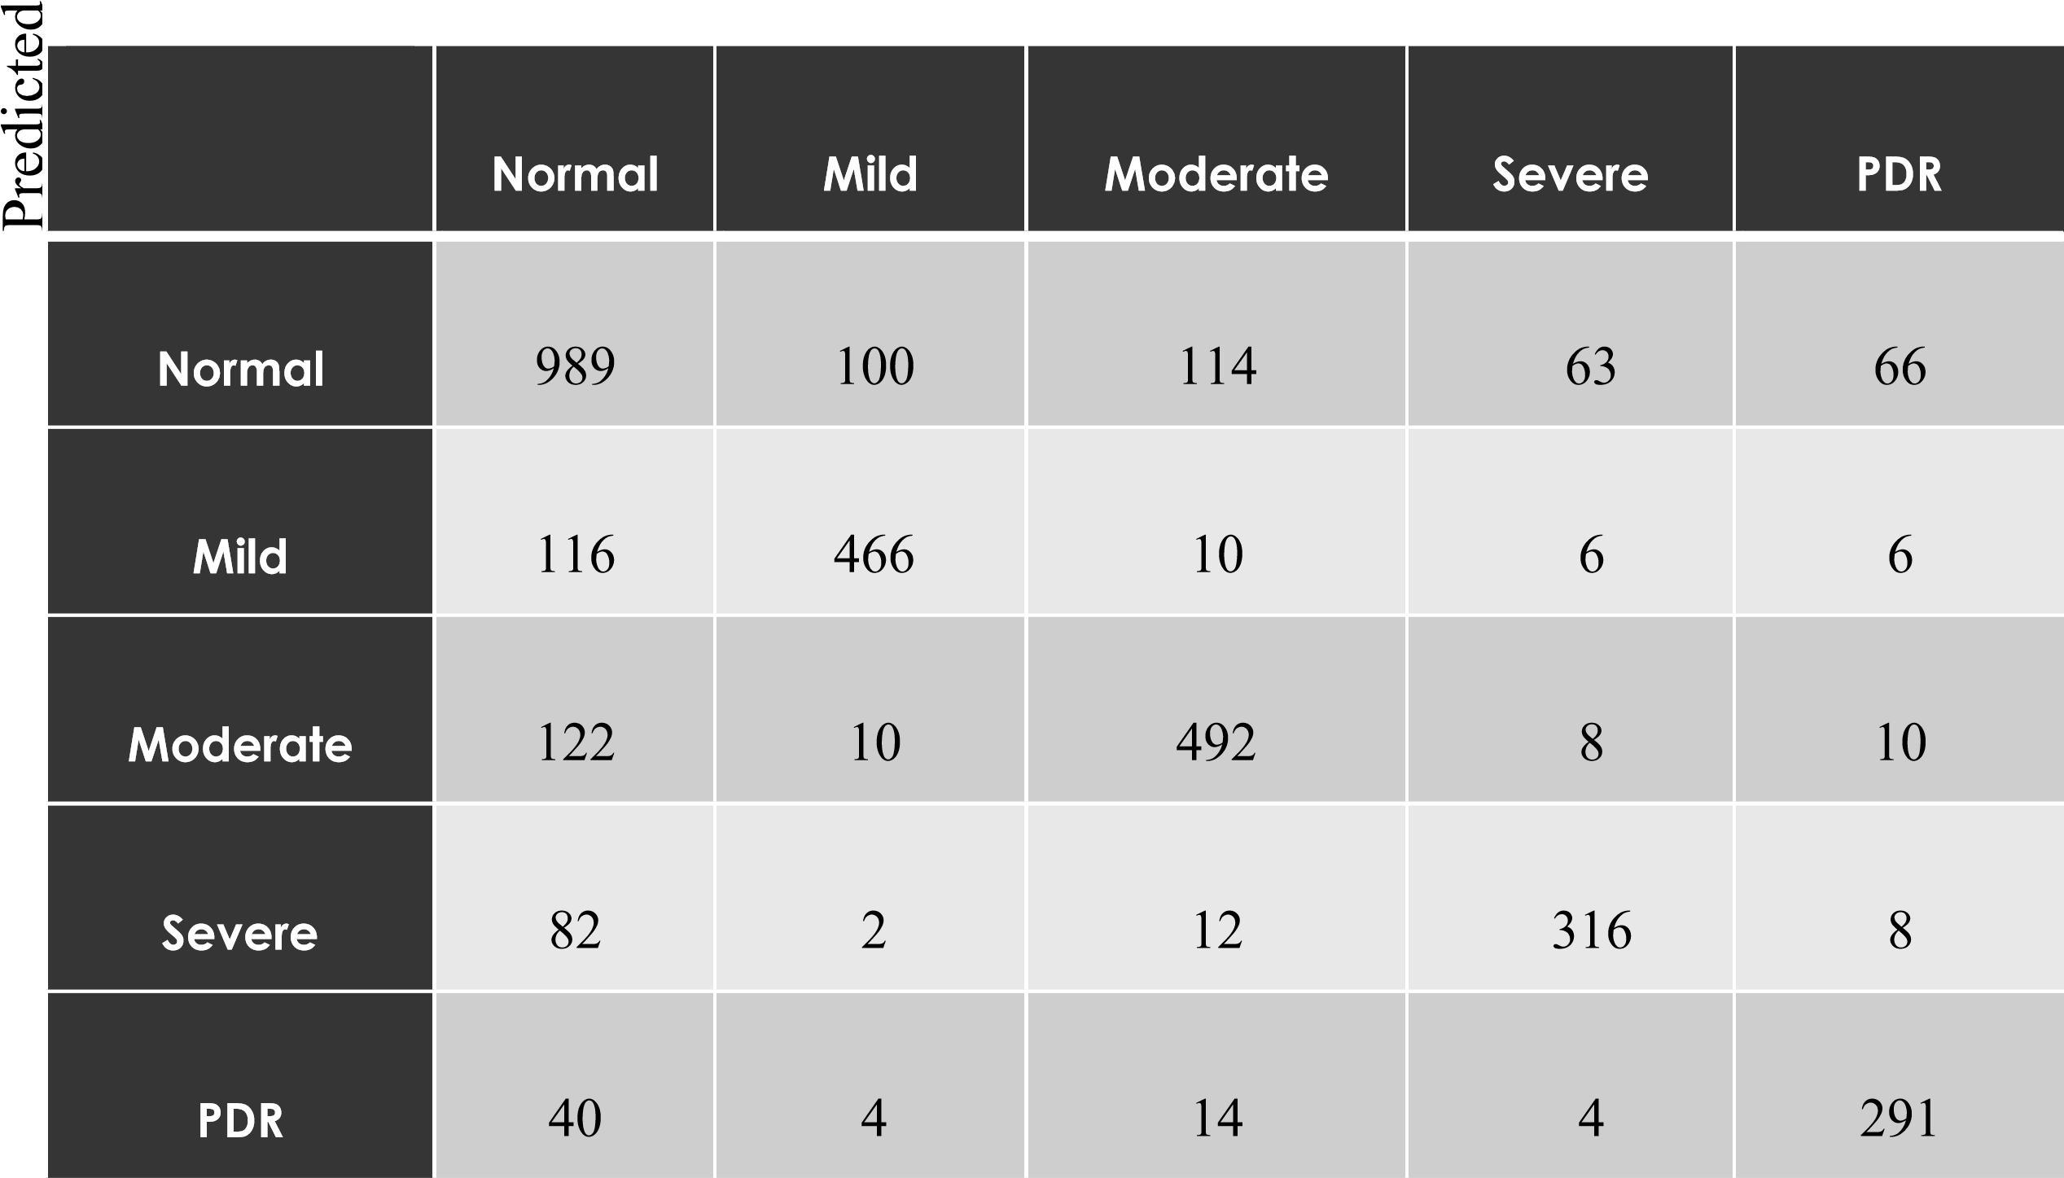
18

Slide 19
Results and Experimental Analysis
19
loss, accuracy = model.evaluate(x_test, y_test) # Print the loss and accuracy print("Test Loss:", loss) print("Test Accuracy:", accuracy)
accuracy: 0.8168 - loss: 0.6874
Test Loss: 0.7155374884605408
Test Accuracy: 0.7000000023841858

Slide 20
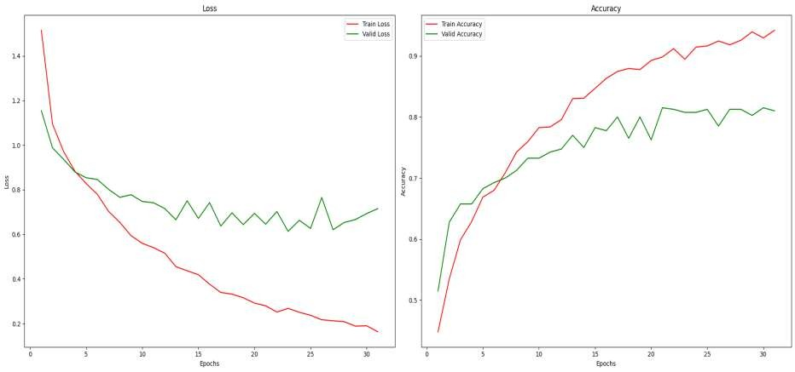
20

Slide 21
Comparison
• Comparison among Random Forest, SVM and Naïve Bayes
21
Metric
Accuracy
Sensitivity
Specificity
Classifier
Random Forest
76.5
%
77.2
%
93.3
%
SVM
47.4
%
48.1
%
61.3
%
Naïve Bayes
36.8
%
43.0
%
58.1
%

Slide 22
Discussions and Conclusion
Accuracy comparison is done to get the best model.
Random Forest classifier shows the best metrics.
Almost in 73.5% case, the model correctly classifies the level of DR.
Finally the performance can be further increased with more diverse data and better features in future.
22

Slide 23
References
23
Akara Sopharak, Matthew N. Dailey, Bunyarit Uyyanonvara, Sarah Barman, Tom Williamson, Khine Thet Nwe& Yin Aye Moe (2010).“Machine learning approach to automatic exudate detection in retinal images from diabetic patients.”Journal of Modern Optics, 57:2, 124-135.
Shailesh Kumar and Basant Kumar (2018). “Diabetic Retinopathy Detection by Extracting Area and Number of Microaneurysm from Colour Fundus Image.” 5th International Conference on Signal Processing and Integrated Networks (SPIN) (2018):, 359-364.
Sohini Roychowdhury, Dara D. Koozekananiand Keshab K. Parhi (2014). “DREAM: Diabetic Retinopathy Analysis Using Machine Learning.”

Slide 24
24
yak, J., Bhat, P. S., Acharya, U. R., Lim, C. M., and Kagathi, M. Automated identification of different stages of diabetic retinopathy using digital fundus images.
Sinthanayothin, C.; Boyce, J.F.; Williamson, T.H.; Cook, H.L.; Mensah, E.; Lal, S.; Usher, D. J. Diabet. Med. 2002, 19, 105–112.

Slide 25
25
THANK YOU

